Slide 1
Introduction to Docker for Data Science
Konstantinos Charalampous
17 December 2018

Slide 2
Contents
Motivation – Problem
What is Docker
Why Docker
Business Value
Docker for Data Science and our AI Systems
Use Case: Containerizing ASA
Final thoughts: First impressions as a beginner in Docker
Further Reading
FULL DISCLOSURE: I AM IN NO WAY AN EXPERT IN DOCKER.
This is my experience on learning and working on Docker for the first time.

Slide 3
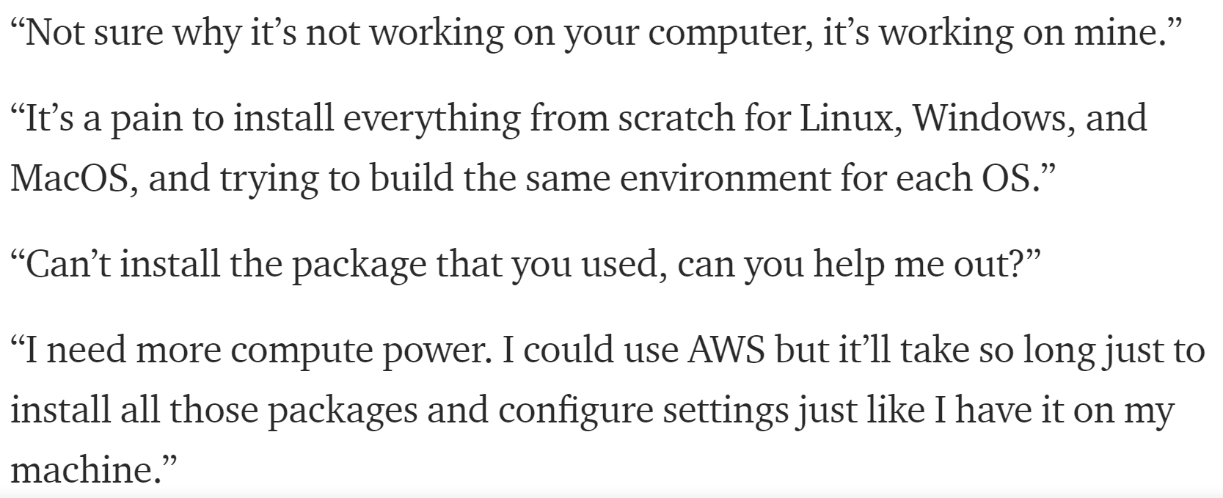
Motivation - Problem

Slide 4
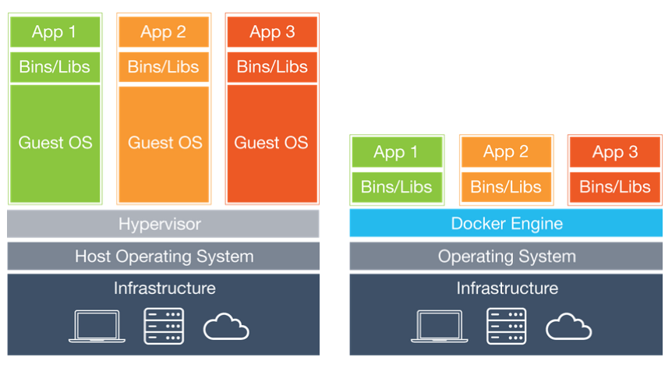
What is Docker
Create, deploy and run applications anywhere
Containers: Package software into a standardized, self-sufficient unit with everything needed to run
Code
Runtime
System tools
Libraries
More lightweight than VM
Virtual Machines
Docker

Slide 5
Why Docker
Avoid manually setting up application environments, dependencies etc.
Reproducible & Consistent
Easier to share projects between different machines
Isolation between applications running on the same machine (no conflicting dependencies)
Automation of deployment, scaling, and management of containerized applications (with Kubernetes)
Notes:
DockerHub

Slide 6
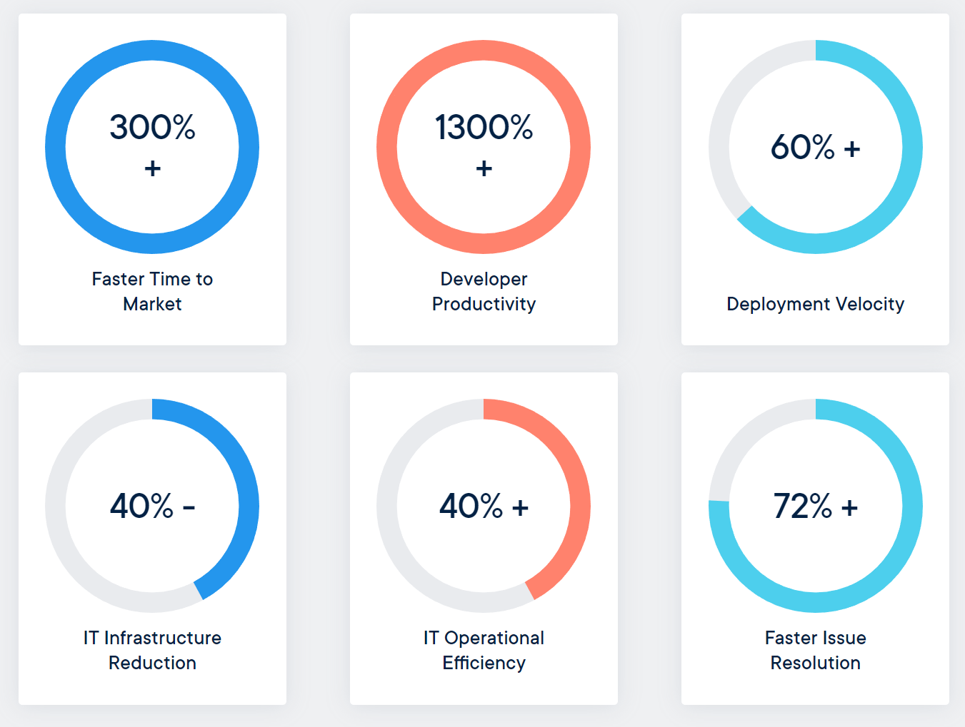
Business Value
Infrastructure cost savings and optimizations
Low server utilization rates, often below 50 percent from 1 application per VM / Bare metal Server
Multiple containerized applications on a single VM / Bare metal server -> Better server utilization
Developer productivity
No need for manually setting up environments
IT Operations efficiency
Faster deployment (less testing)

Slide 7
Docker for Data Science
Automate, share and reproduce research code / experiments
Create easy-to-use Data Science sandboxes
Use many out-of-the-box Data Science environments freely available (Jupiter notebooks, TensorFlow etc.)
Package and deploy Data Science applications / Machine Learning APIs that serve predictions
Large scale data analysis and machine learning in cloud environments

Slide 8
Use Case:
Containerization of Automatic Sentiment Analysis (ASA) using Docker and Anaconda (Miniconda)

Slide 9
Anaconda (Miniconda)
“Anaconda is a free and open-source distribution of the Python and R programming languages for scientific computing, that aims to simplify package management and deployment. “
Basically, it creates virtual environments with a specific python versions and python packages that isolate project dependencies.
Anaconda comes with a ton of pre-installed scientific packages installed. Miniconda is a more lightweight distribution.

Slide 10
Use Case: Containerization of Automatic Sentiment Analysis (ASA) using Docker and Anaconda (Miniconda)
In the same directory there should be the following:
Sentiment Analysis Source Code
Pandas – Data handling / analysis
Numpy – Mathematical functions on arrays
Sci-kit learn – Machine Learning / Sentiment Classification
environment.yml – The blueprint of the Anaconda virtual environment
Python 3.6.5
Project Dependencies
Dockerfile – The set of rules that define the docker image
Ubuntu 16.04
Miniconda
Copy source code to the container
Create the conda virtual environment

Slide 11
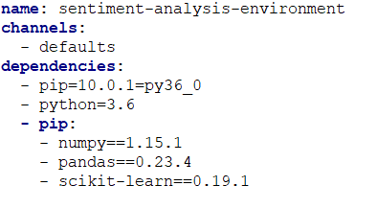
Use Case: Containerization of Automatic Sentiment Analysis (ASA) using Docker and Anaconda (Miniconda)
environment.yml

Slide 12
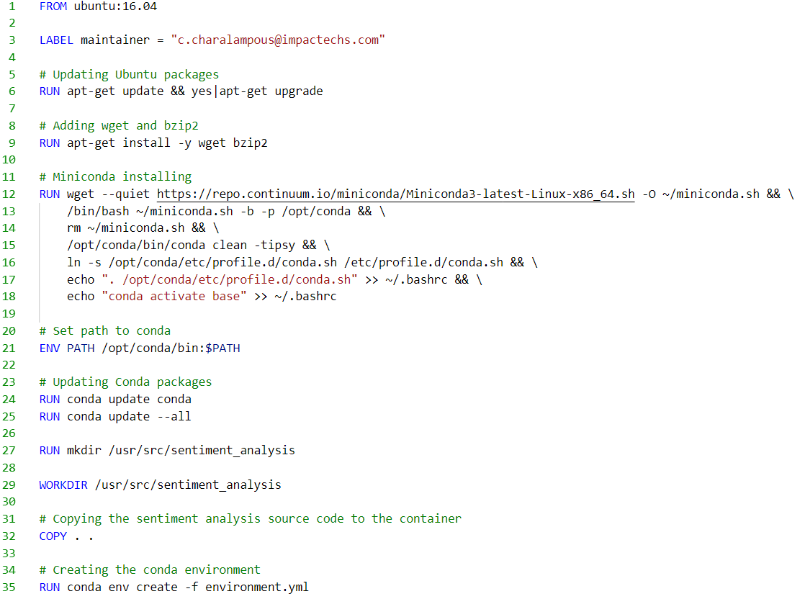
Use Case: Containerization of Automatic Sentiment Analysis (ASA) using Docker and Anaconda (Miniconda)
Dockerfile

Slide 13
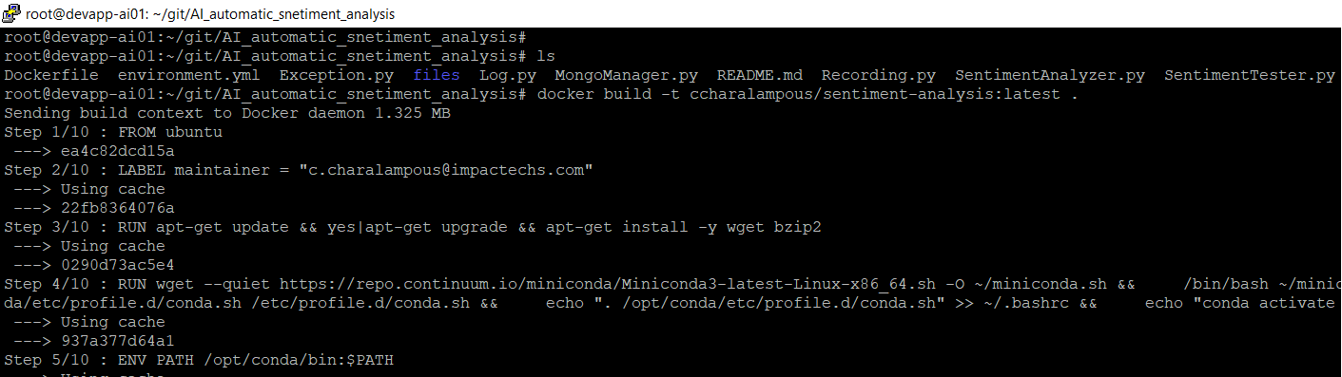
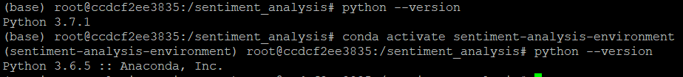
Use Case: Containerization of Automatic Sentiment Analysis (ASA) using Docker and Anaconda (Miniconda)

Slide 14
Final thoughts: First impressions as a beginner in Docker
Fairly easy to get started with simple scenarios
A lot easier to write a Dockerfile once than to replicate an environment manually each time
Can get a bit more complicated with more complex scenarios (containers interacting with other containers etc.), but still, you write the configurations only once and that’s it
A lot of material online for almost any use case
Great way to guarantee machine learning prediction reproducibility

Slide 15
Further Reading
Docker Documentation
https://docs.docker.com/
Docker Tutorials/Courses
https://go.digitalocean.com/containers-and-microservices.html
https://classroom.udacity.com/courses/ud615
Docker Business Value
https://goto.docker.com/rs/929-FJL-178/images/WP_BusinessValueofDocker_06.26.2017.pdf
Docker for Data Science
https://towardsdatascience.com/docker-for-data-science-9c0ce73e8263
https://blogs.technet.microsoft.com/machinelearning/2018/03/15/demystifying-docker-for-data-scientists-a-docker-tutorial-for-your-deep-learning-projects/

